Slide 1
Using Github

Slide 2
Git vs Github
Github is a repository of files (think dropbox or google docs)
Git is a version control system and looks at who has changed files when and if there are conflicts
Github repositories (repos) are formed by either forking another repo or creating one from scratch

Slide 3
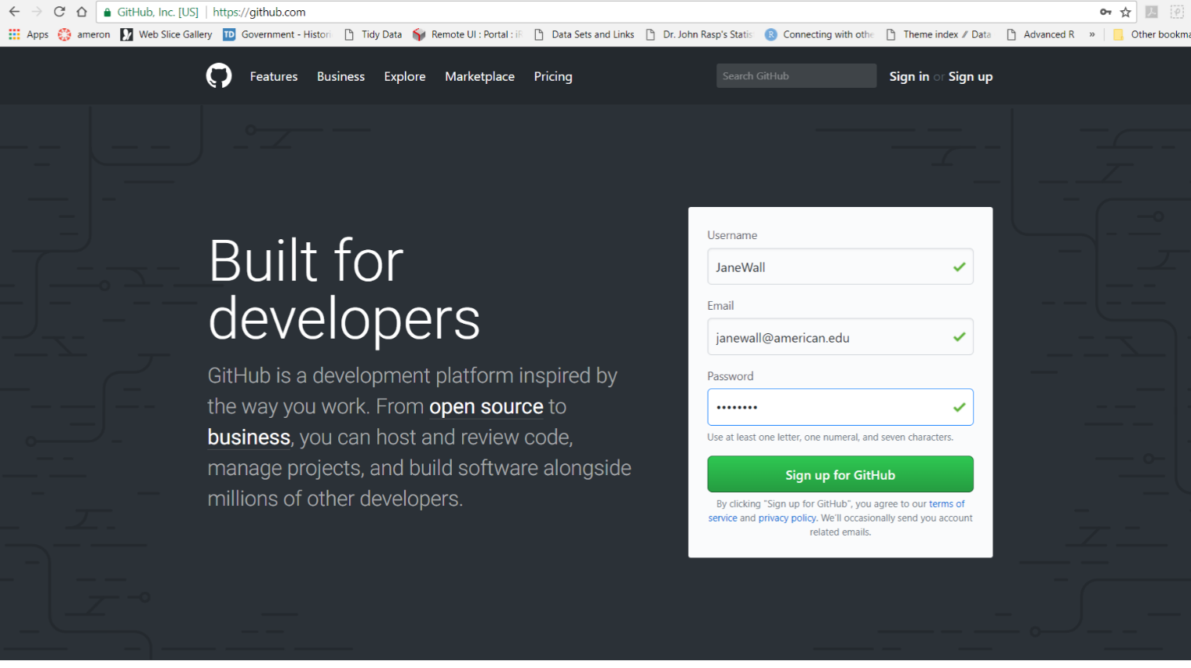
Creating a Github repo from scratch
First, create a github account
Go to www.github.com and sign up for an account

Slide 4
We will now work through the Guide
Repo organizes a single project and can include your R markdown files, folders, datasets, spreadsheets, images, videos, etc.
Each repo should include a README file with info about the project
We will create a repo called Data Science Class Project (or you can name it something different if you want to). You might want to store your project here – then potential employers can see what you have done

Slide 5
Add a new repo
Upper right corner, click the + and select New repository
Name your repo
Write a short description
Initialize this repository with a README

Slide 6
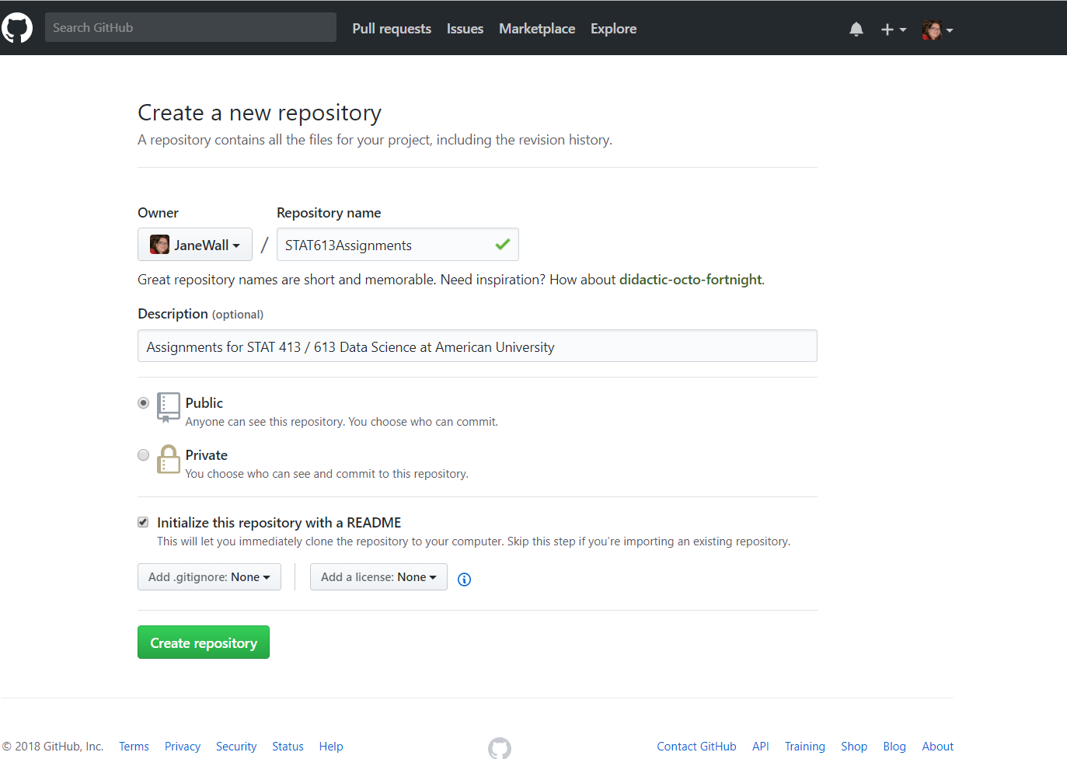

Slide 7
Modify the README
Click Create Repository
Then click the edit button on the README and add a better description to your file
Commit the change

Slide 8
Branches
There is always a master branch
A branch off the master makes a copy of the master for you to modify
Make changes to the branch
Submit pull request
When accepted, the changes get merged into the master branch
Click the drop down where it says branch:master
Enter a branch name
Click Create branch box

Slide 9
How to integrate changes to the Master
Make some sort of change to the branch (maybe upload a file or change the README)
Click commit change after putting a description of the change into the comments
This change is now only in the branch
Open a pull request to get it into the master – particularly useful when collaborating with others

Slide 10
Pull Request
Click the pull request tab
Enter a description of the changes you made
Submit the pull request
As the owner of the master, you will now decide whether or not to accept those changes and merge into the master
Once merged, the master and branch will be the same
You can then delete the branch if you want to.

Slide 11
Create a local copy of your repo
Work offline or just play around with ideas before putting them in the repo on github
Go to https://git-scm.com/downloads and download and install git for your machine
Choose the option to use git from the command line and also from 3rd party software
Create a directory where you will store the local copy of the repo
$ mkdir ~/test_repo
Make the new directory your current directory
$ cd ~/test_repo

Slide 12
Link the new local repo to the remote one
Initialize a local git repo in the current location
$ git init
Connect the two repos (local and remote)
$ git remote add origin https://github.com/JaneWall/STAT613Assignments.git
At this point a folder called git has been added to the local folder
Look at the folder and find the folder you created.
How do the files get added?

Slide 13
Clone the files
We now add the files from the github repo to our local folder
$ git clone https://github.com/JaneWall/STAT613Assignments.git

Slide 14
Now let’s hack some code
Fork Hadley’s tidy-science-in-tidyverse repo
This makes a copy of his repo and puts it in your list
Only needed if you are going to make changes to the file and suggest he combine them with his work
Look at your github account now and you will see this repo in your list and show it as forked from Hadley
Now we can make a local copy of this repo on our computer to play with and it will not disturb anything Hadley is doing with the code
We could have done this part without forking it first and just cloned it straight from Hadley’s repo

Slide 15
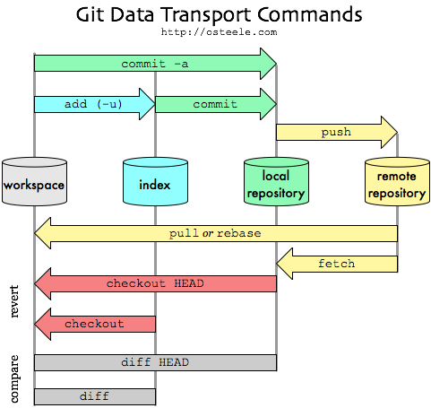
Git manages versions of the files

